Slide 1
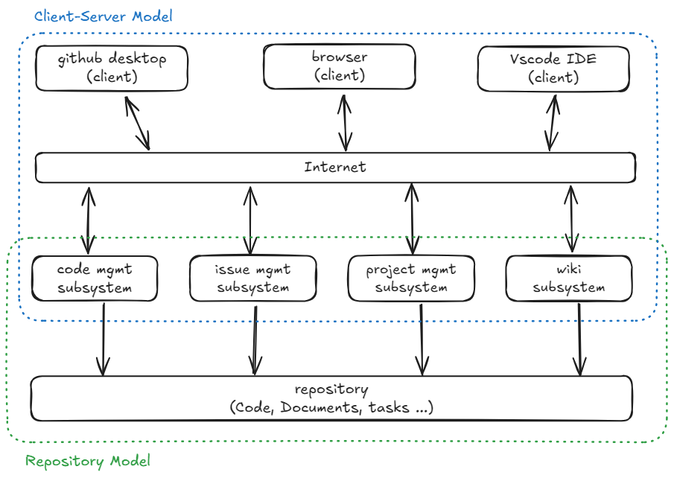
System Design Example
Group Name:
Old-Folks
Group Member:
Cheng Bao,
Xinxin Qiu,
Dinggen Zhang
Example System:
Github
Model Used:
Hybrid with Repository Model & Client-Server Model

